Slide 1
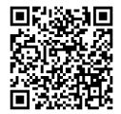
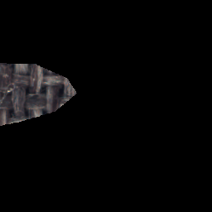
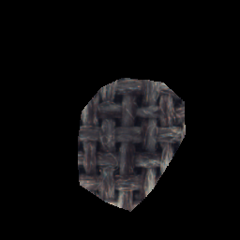
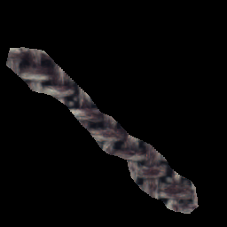
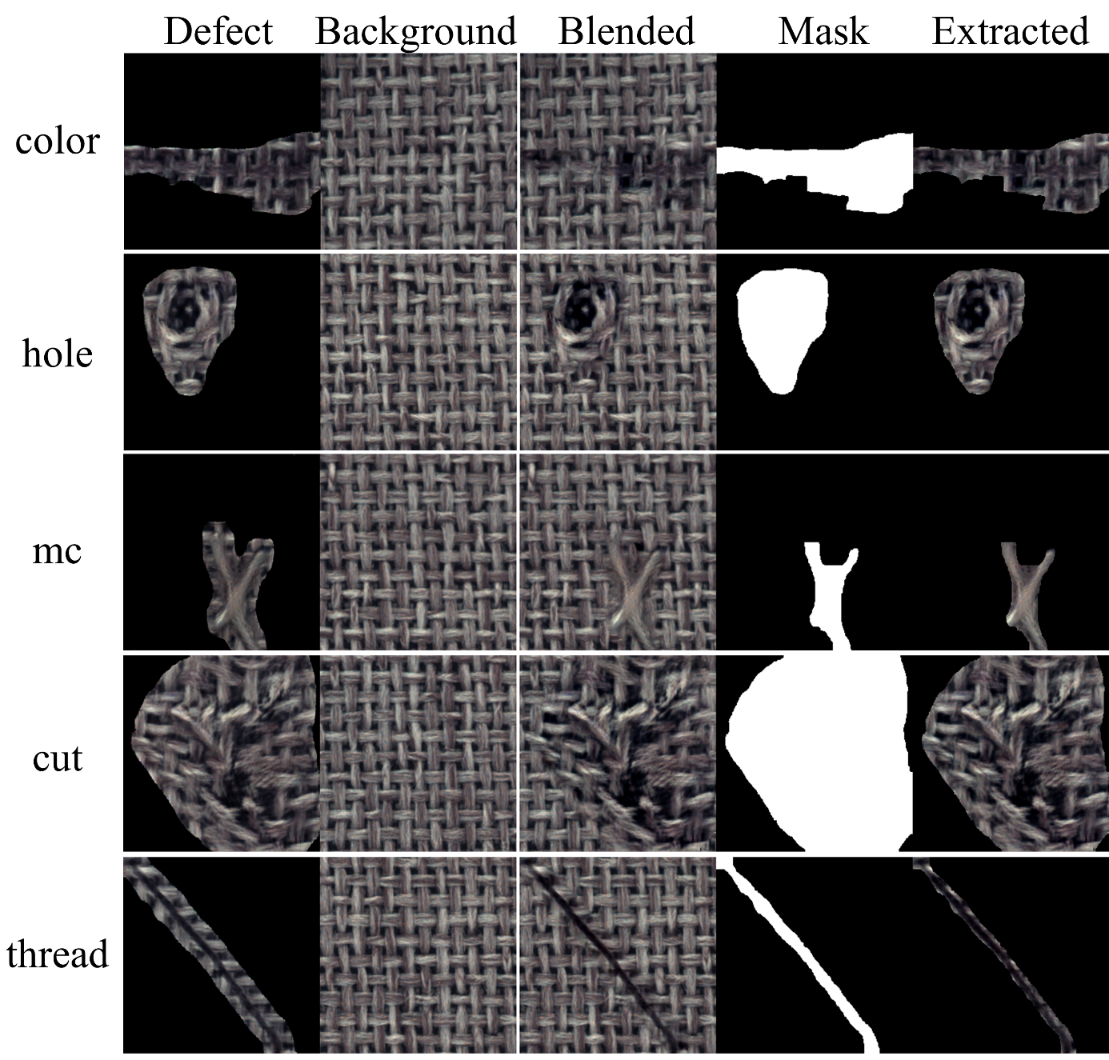
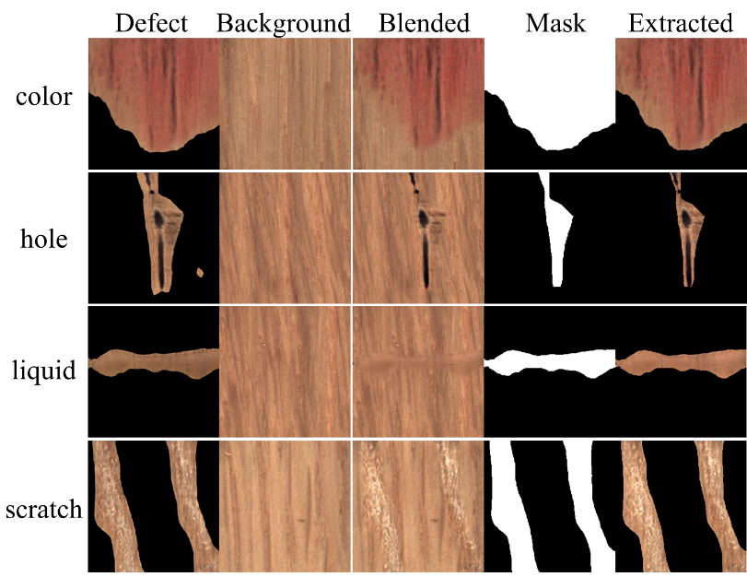
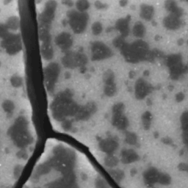
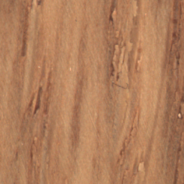
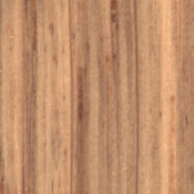
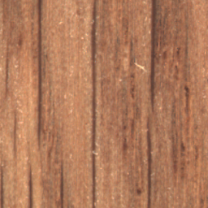
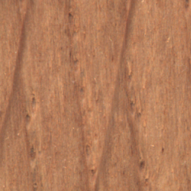
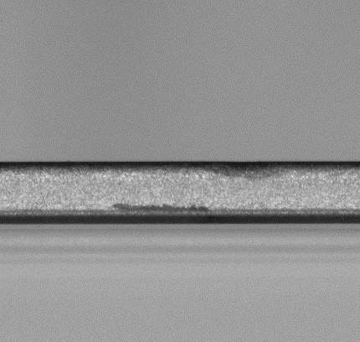
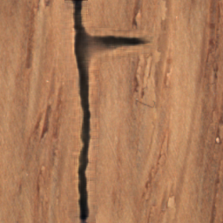
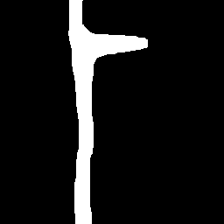
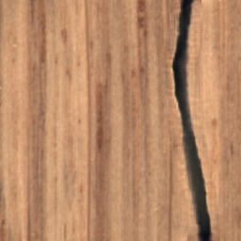
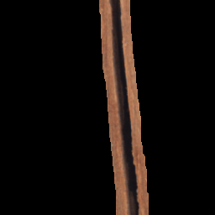
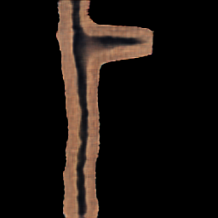
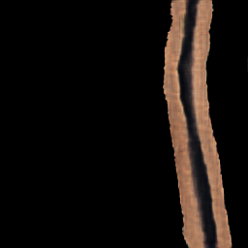
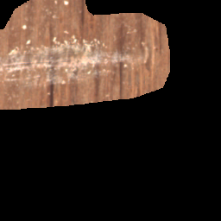
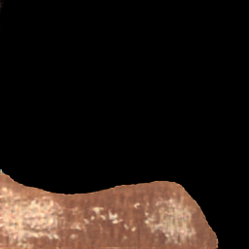
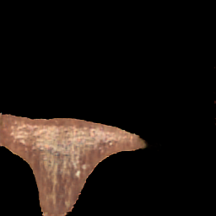
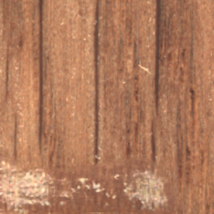
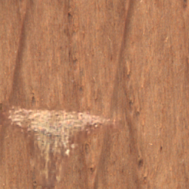
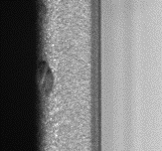
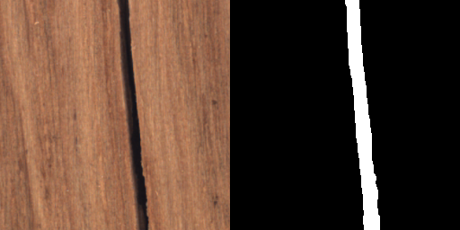
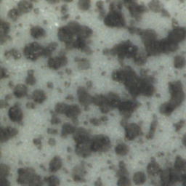
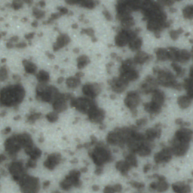
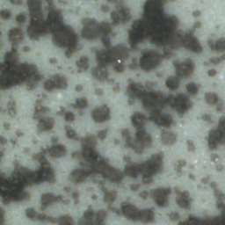
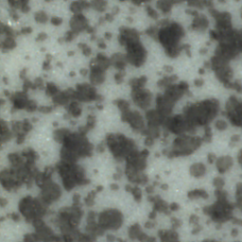
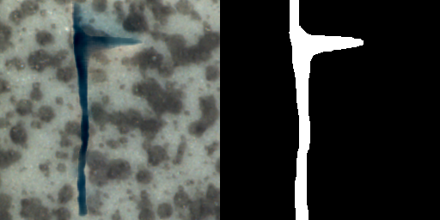
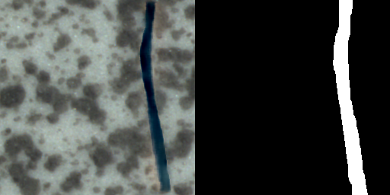
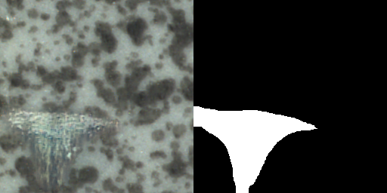
Diversified and Multi-Class Controllable Industrial Defect Synthesis for
Data Augmentation and Transfer Jing Wei^{1,2} Fei Shen^{1,2,3} Chengkan Lv^{1,2,3} Zhengtao Zhang^{1,2,3} Feng Zhang^{1,2,3} Huabin Yang^{1,2,3}
¹Institute of Automation, Chinese Academy of Sciences ²The School of Artificial Intelligence, University of Chinese Academy of Sciences ³CASI Vision Technology CO.
Proposed methods:
Synthesis results:
Segmentation results:
Diversified and multi-class Controllable Defect Generation Adversarial Networks based on constant source image (DCDGANc)
Diversity comparison. The Training contains all defect contents in the training sets.
AUC/F1 on ResNet- and U-Net-based models:
Dataset |  | Wood | Carpet
Res | Raw | 0.9891/0.8462 | 0.9812/0.7497
 | Augment | 0.9891/0.8227 | 0.9862/0.7833
 | Enlarge | 0.9903/0.8486 | 0.9901/0.7961
U-Net | Raw | 0.9936/0.8784 | 0.9846/0.7776
 | Augment | 0.9943/0.8778 | 0.9851/0.7967
 | Enlarge | 0.9945/0.8896 | 0.9903/0.8135
Training
Generated
Category control and blending results.
Defect transfer and zero-shot detection:
Wood defects are fused to the normal backgrounds of MVTec-tile as the transferred defect samples of the crack and the rough.
real
Blended Extracted Generated Mask
Blended Extracted Generated Mask
crack
Contributions:
DCDGANc generates defect contents with pure backgrounds.
Generating diversified defects by modulation of OD-SPADE (One-Dim Spatially Adaptive Normalization) .
Fusing defects into normal backgrounds by our improved Poisson blending, where real normal contents are totally retained.
Constructing constant input for generator to control the category of generated defects.
rough
Only the transferred results are used to train segmentation models, and all the real tile defects are used as the test set:
Defect Model | Crack | Rough
Res | 0.9896/0.6876 | 0.9688/0.8376
U-Net | 0.9919/0.7279 | 0.9790/0.8129
Synthetic results on phone band.
normal backgrounds
Overall schema:
compositing results and refined binary masks
Original
Real
Defect Background Blended Mask Extracted
training set
diversified generated samples
Sample $z\sim 𝒩(0, I)$
Segmentation Models
Code is avalible at:
https://github.com/cg-light/DCDGANc
For further communication:
Email: weijing2020@ia.ac.cn WeChat:
DCDGANc
$$c_{1}$$
Improved Poisson Blending
$$……$$
$$c_{2}$$
$$……$$
Improve detection performance
extract
Given class label
binary masks
new backgrounds
transferred results and refined binary masks
few real samples
$$c_{1}$$
Transfer
Segmentation Models
$$c_{2}$$
$$……$$
Zero-shot detection
Notes:
1

